Slide 1
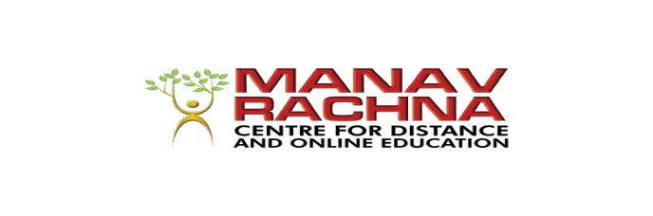
Centre for Distance and Online Education
COURSE:
ORGANIZATIONAL BEHAVIOUR
Course Outcome:
Appreciate the importance of managing cross culture workforce and teams
Topic: Understanding Work Teams; Communication
Ms. Amrisha Minocha

Slide 2

Understanding Work Teams
Group behavior is a fundamental aspect of organizational life, shaping how individuals interact, collaborate, and achieve common goals within teams. Understanding the foundations of group behavior is essential for leaders and team members alike to navigate the complexities of group dynamics effectively. The key foundations of group behavior, including group formation, structure, norms, cohesion, and communication, and their impact on team performance and effectiveness

Slide 3
Defining Work Teams
Work teams are groups of individuals within an organization who come together to accomplish specific tasks, projects, or objectives. Unlike traditional hierarchical structures, work teams are characterized by shared accountability, mutual interdependence, and collective responsibility for achieving common goals. Work teams can take various forms, including cross-functional teams, project teams, virtual teams, and self-managed teams, each serving unique purposes and functions within organizations.

Slide 4
Characteristics of Work Teams
Common Purpose: Work teams are formed with a shared purpose or objective, whether it's completing a project, solving a problem, or delivering a product or service. A common purpose provides clarity and alignment, guiding team members' efforts and actions towards achieving collective goals.
Common Purpose: Work teams are formed with a shared purpose or objective, whether it's completing a project, solving a problem, or delivering a product or service. A common purpose provides clarity and alignment, guiding team members' efforts and actions towards achieving collective goals.

Slide 5
Characteristics of Work Teams
Common Purpose: Work teams are formed with a shared purpose or objective, whether it's completing a project, solving a problem, or delivering a product or service. A common purpose provides clarity and alignment, guiding team members' efforts and actions towards achieving collective goals.
Clear Roles and Responsibilities: Work teams have clearly defined roles, responsibilities, and expectations for each team member. Clear roles minimize confusion, conflicts, and duplication of efforts, ensuring that everyone understands their contribution to the team's success.

Slide 6
Characteristics of Work Teams
Shared Accountability: In work teams, members share accountability for the team's performance and outcomes. Team success is a collective responsibility, with each member contributing to achieving goals and delivering results.
Effective Communication: Effective communication is essential for work teams to coordinate activities, share information, and resolve conflicts. Open, honest, and timely communication fosters trust, transparency, and alignment among team members, enhancing team cohesion and performance.

Slide 7
Strategies for Success
Establish Clear Goals and Objectives: Clearly define the goals, objectives, and deliverables of the work team to provide direction and focus. Ensure that team members understand the purpose of the team and how their efforts contribute to achieving organizational goals.
Build a Diverse and Complementary Team: Create work teams with diverse backgrounds, skills, and perspectives to foster creativity, innovation, and problem-solving. Balance technical expertise with interpersonal skills and ensure that team members complement each other's strengths and weaknesses.

Slide 8
Strategies for Success
Foster Trust and Collaboration: Create a culture of trust, collaboration, and mutual respect within the work team. Encourage open communication, active listening, and constructive feedback to build strong relationships and foster a supportive team environment.
Provide Resources and Support: Equip work teams with the resources, tools, and support they need to succeed. Ensure access to training, technology, and other resources necessary for accomplishing tasks and achieving goals.

Slide 9
Strategies for Success
Encourage Autonomy and Empowerment: Empower work teams to make decisions, take ownership of their work, and self-manage their activities. Provide autonomy and flexibility in how tasks are accomplished, allowing teams to innovate and adapt to changing circumstances.

Slide 10
Communication
At its essence, communication refers to the transmission of information from one entity to another. This exchange can occur through various mediums, including speech, writing, gestures, and body language. However, communication is not merely about transferring data; it involves the imparting of meaning, understanding, and shared experiences between individuals. At its core, communication can be defined as the process of exchanging information, ideas, thoughts, and feelings between individuals or groups. It is a dynamic interplay that transcends mere verbal exchanges, encompassing a rich tapestry of linguistic, non-verbal, and contextual elements. Communication is the medium through which we connect, understand, and relate to one another, forging bonds that bind us together in shared understanding and empathy

Slide 11
Importance of Communication
Effective communication is vital for the functioning of society, organizations, and interpersonal relationships. It fosters collaboration, facilitates problem-solving, and promotes harmony among individuals. In professional settings, effective communication skills are often cited as one of the most desirable traits in employees, as they contribute to productivity, innovation, and overall success.

Slide 12
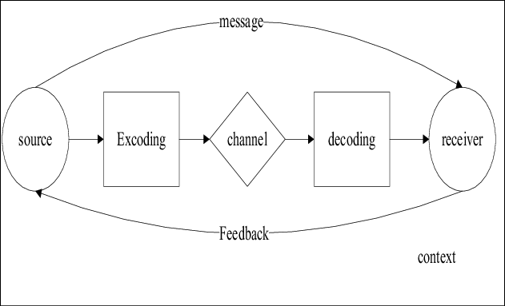
The Process of Communication

Slide 13
Models of Communication
Various models have been developed to conceptualize the complex dynamics of communication. One of the earliest and most influential models is the Shannon-Weaver model, which depicts communication as a linear process consisting of a sender, a message, a channel, noise, and a receiver. This model highlights the potential for interference or distortion of the message during transmission.
Another prominent model is the transactional model, proposed by communication scholars Barnlund and Berlo, which emphasizes the reciprocal nature of communication. In this model, communication is seen as a continuous exchange of messages between sender and receiver, with both parties simultaneously acting as communicators and interpreters.

Slide 14
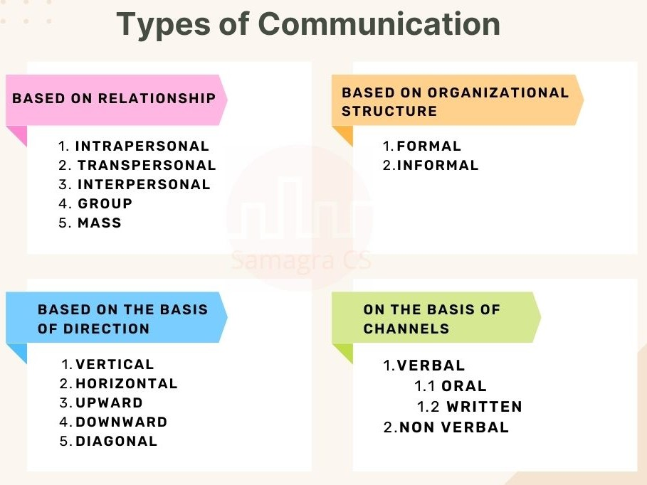
Types of Communication

Slide 15
THANK YOU

